Slide 1
IOOS Biological Data Training Workshop February 8-9, 2018 University of Washington Seattle, WA
Organized by IOOS, NANOOS, OBIS-USA, and Ocean Teacher Global Academy

Slide 2
Workshop Overview
IOOS Program Office Staff:
Gabrielle Canonico - MBON Program Manager
Jennifer Bosch, PhD - Marine Ecologist/Oceanographer

Slide 3
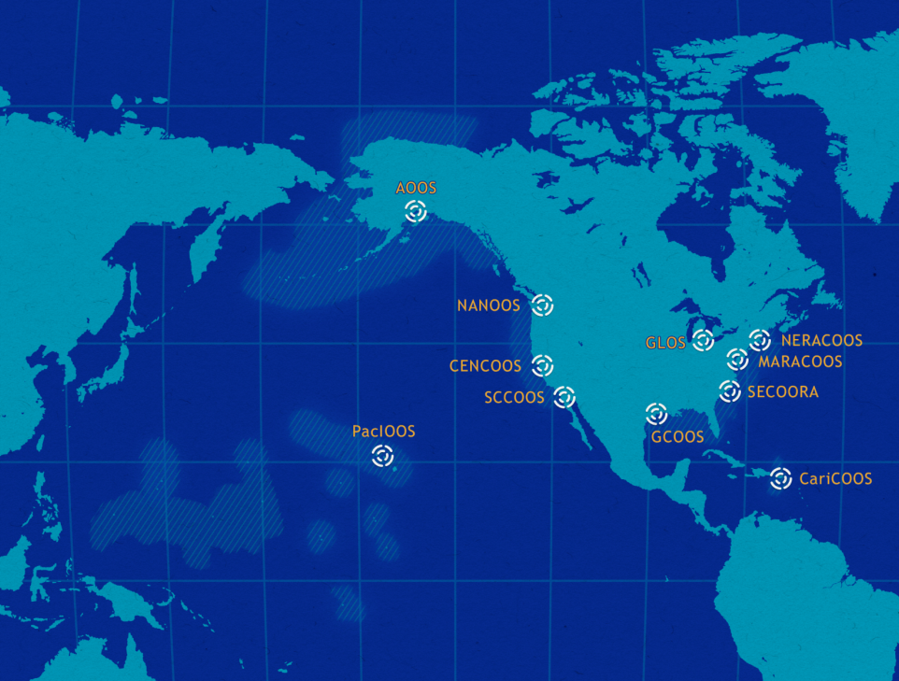
U.S. Integrated Ocean Observing System (IOOS) works with 11 Regional Associations and 17 Federal agencies to build this observing network and distribute information
Collaboration | Cooperation | Teamwork

Slide 4

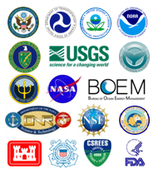
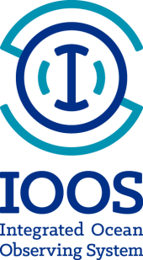

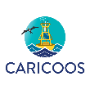





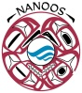

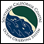

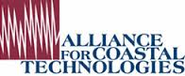

IOOS is Regional to National to Global

Slide 5
A Biological Component for US IOOS
Long-term species observations are required if we are to understand impacts of change, and to protect, sustainably harvest, and preserve the ocean resources we rely on – from microbes to whales.
IOOS has made considerable progress advancing physical and chemical observing systems and is engaged in the global dialogue to integrate biology into the global observing system.
IOOS strategic plan identifies a goal of providing operational, long-term biological observations and access to biological data.
More work is needed across the community to advance biology as a critical part of IOOS.

Slide 6
IOOS Biological Core Variables
Recommended by the Biological Integration and Observation (BIO) Task Team – expands the previous list of IOOS biological variables.
Species and abundance
Phytoplankton, zooplankton, fish, corals, invertebrates, marine mammals, microbes, sea birds, sea turtles, and submerged aquatic vegetation
Benthic and pelagic
Biological vital rates
Includes (but is not limited to) production, recruitment, mortality, fecundity, growth, feeding rates , and microbial activity.
Nekton diet
Diets of fish, seabirds, sea turtles, and marine mammals
Sound
Notes:
IOOS biological data variables
Of the 26 data variables listed early in the history of the program, IOOS previously listed 5 biological variables. These were primarily species and abundance for certain groups and did not sufficiently represent biological communities and information needs in our area of coverage.
The BIO TT expanded that list but also refined it based on extensive input from federal agencies and the scientific community.
If asked about sound:
Sound is a fundamental ocean property, which originates from biological (e.g., marine mammals, soniferous fish, snapping shrimp), physical (e.g., wind, surface waves, sea ice), geological (e.g., earthquakes), and anthropogenic (e.g., ships, air guns) sources, and affects many aquatic species. Analogous to ocean color, measurement of sound enables derivation of numerous variables, such as marine mammal and fish presence, wind speed estimates, and ambient noise. Sound provides a natural bridge between some of the physical and biological elements of an ocean ecosystem.

Slide 7
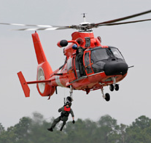
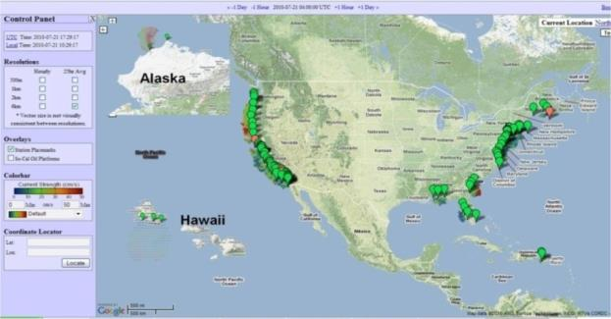
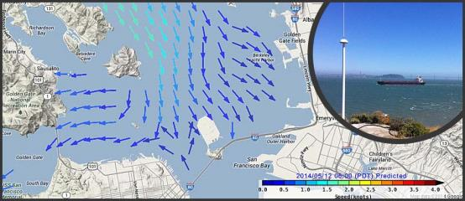

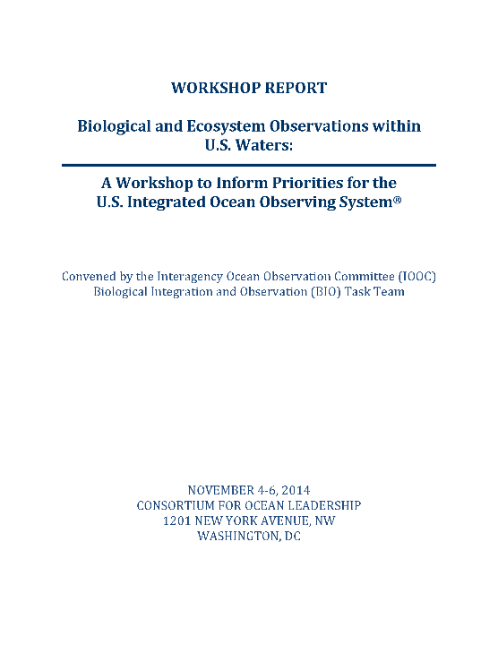

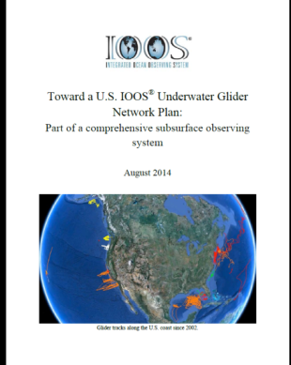
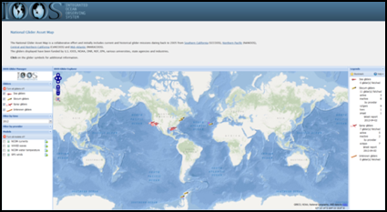
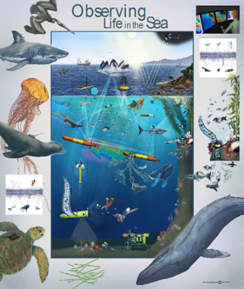
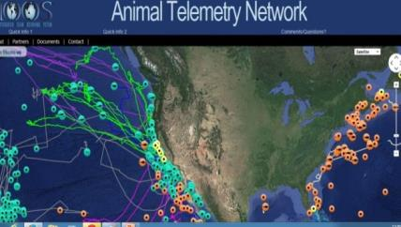
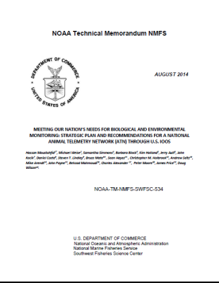
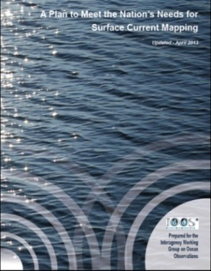
IOOS is Advancing Communities
HF Radar:
Biological Data and Biological Variables:
Gliders:
Marine Biodiversity Observation Network (MBON):
Animal Telemetry:
Wave Measurements:
Notes:
Another niche we’ve created is in the area of “communities of practice”. In each of these examples we are actively engaged in projects to improve a communities ability to deliver information for societal benefit.
Here are five areas we have endeavored to bring the community together.
High Frequency Radar:
130 radars run by academic institutions, Program Office manages on the data management
Create a national network from individual operators
Data into PORTS® and NWS data tanks (AWIPS).
Gliders:
Common Operating Standards
White Paper Towards a National Glider Network published in August 2014
Glider Data Assembly Center capability
Starting a Task Team under the IOOC
Waves – National Plan with NOAA, IOOS and USACE. IOOS Regions have increased the number of data well buoys in particular in Caribbean and Insular Pacific. USACE fund the data management central system and is a contributor to IOOS.
ATN:
This is in early stages for US IOOS. Within the United States the tagging efforts are in response to scientific research as Regional basis and much of it being done in our academic community. There is not a national tagging program within the United States.
The US IOOS is supporting the coordination of data coming from the community of taggers. Current focus is on data management and building an ATN Data Assembly Center. The DAC will have the capability to integrate most Animal Telemetry Technology (Acoustic, Archival and Satellite tags).
Biological Data and Biological Variables
Biological Integration and Observation (BIO) Task Team national plan solicited broad federal and scientific community input to refine IOOS core biological variables and incorporate biology into IOOS.
2018 IOOS Biological Data Training Workshop in coordination with OBIS-USA, international OBIS, and IOC OceanTeacher Global Academy BIO TT–National Plan with NOAA, IOOS and USACE. This system will incorporate more biological research into our data catalog.
2010 MBON workshop sponsor and contributor; leading coordination of US MBON demonstration projects

Slide 8
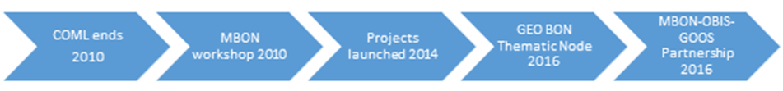
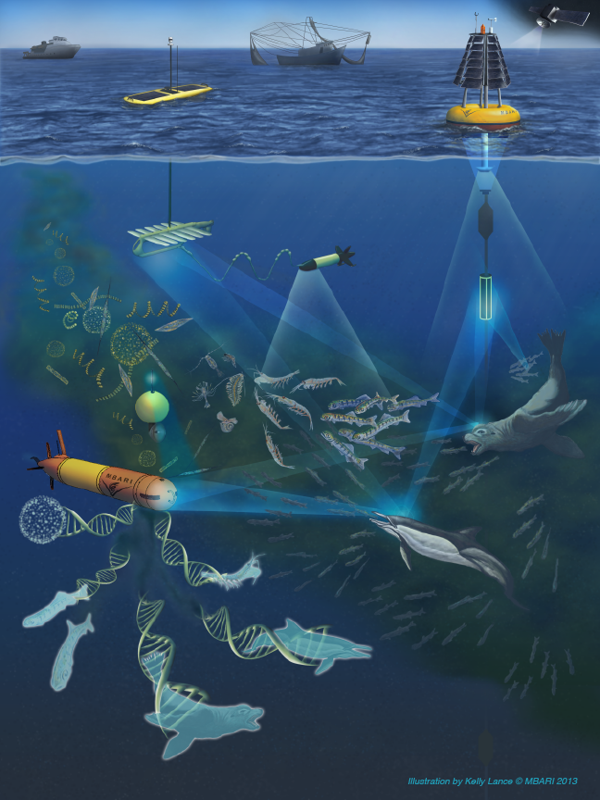
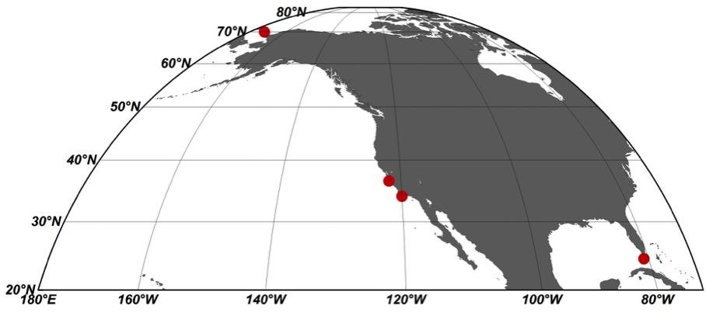
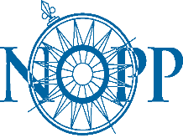
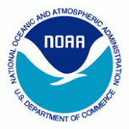

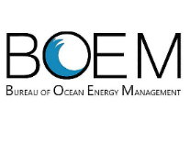
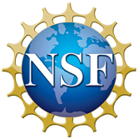


US MBON Demonstrations
Three US MBON demonstrations: Santa Barbara Channel; Arctic; Sanctuaries MBON (Florida Keys, Flower Garden Banks, Monterey Bay).
~17M from NASA, NOAA, BOEM, NSF and industry
USGS/OBIS-USA and IOC/IODE/OBIS data partnership
Smithsonian/Marine GEO involvement
Chukchi Sea
Monterey Bay
Credit: MBARI
Channel Islands
Florida Keys

Slide 9
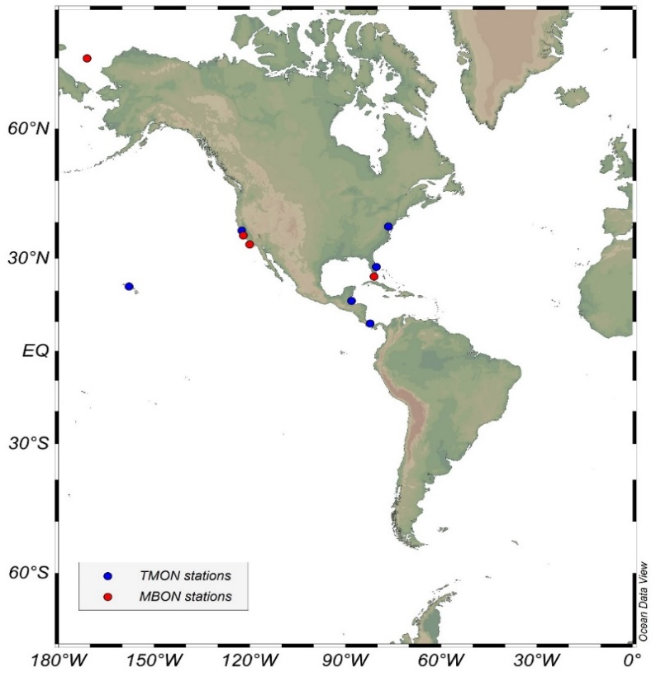



MBON P2P: Starting in the Americas
Arctic
Canada
USA
GEO Plenary, Mexico (2015)
Convention of Biological Diversity (Montreal, Apr 24, 2016)
GEO BON Open Science Meeting (Leipzig, Jul 4-6,2016)
Pole-to-Pole in the Americas Workshop (Puerto Morelos, Mexico, Sep 26-30, 2016)
GEO-XIII Plenary (St Petersburg, Russia, Nov 9-10, 2016)
Animal Telemetry Netw. – Mar’17
OBIS Workshops
GEO Plenary-Oct 2017
AmeriGEOSS – Aug 2018 Brazil
Mexico
Belize
Panama
Colombia
Ecuador
Brazil
Chile
Argentina
Peru
Antarctica

Slide 10
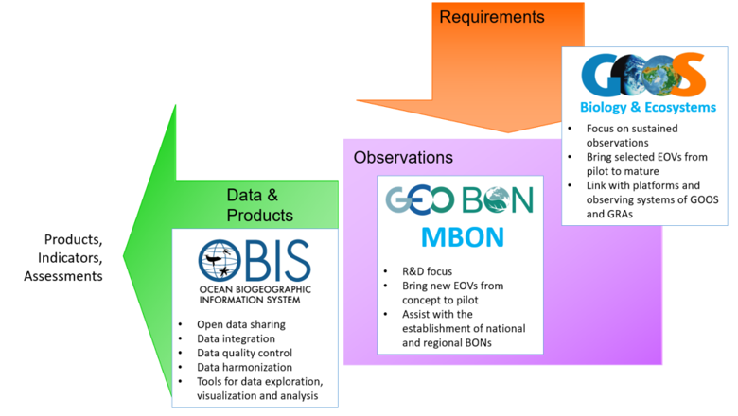
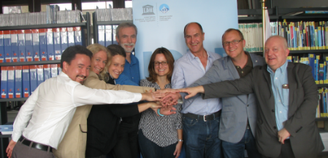
Global Collaboration for Biological Observing
http://iobis.org/2016/12/15/goosgeobonobis/

Slide 11
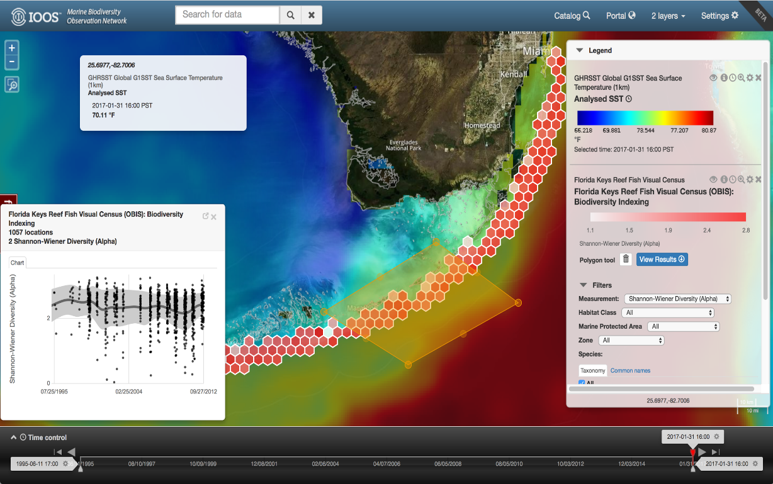
MBON Portal
Built by Sanctuaries MBON and Axiom teams; sustained by US IOOS
Access to and interactive visualizations of biological data
Version 2.0 improvements based on user input
Interest in building a portal and tools the RAs and a broad suite of partners can use

Slide 12
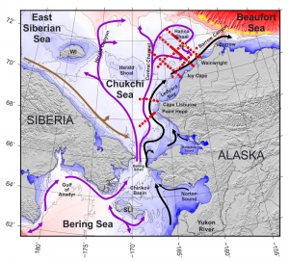
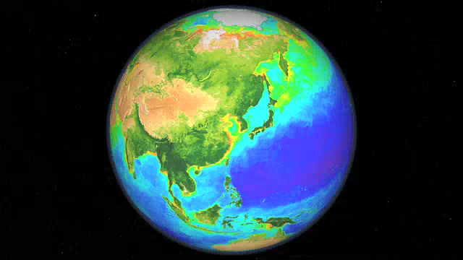
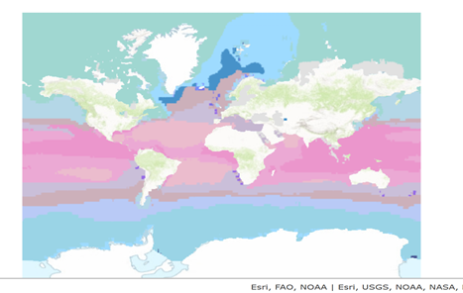
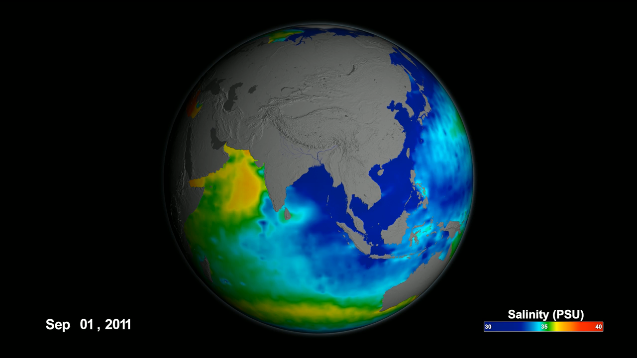
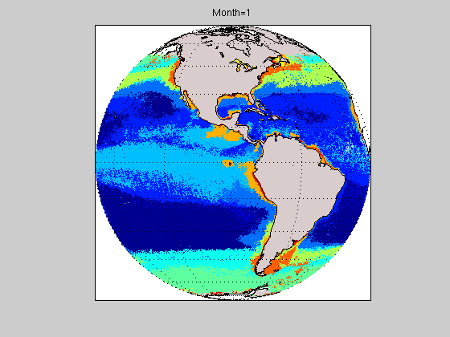
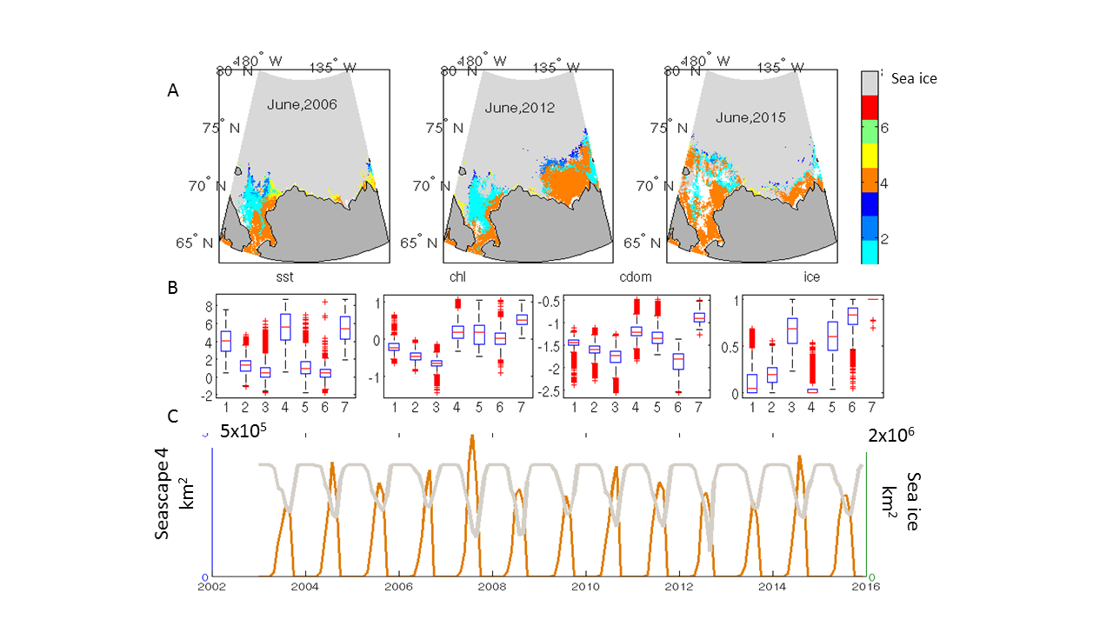
Dynamic seascapes: biogeographic framework for a global MBON
Maria Kavanaugh (OSU)
mkavanau@ceoas.oregonstate.edu
J. Grebmeier (U. MD), D.Otis ,E. Montes, F Muller Karger (USF),
D. Wright (ESRI), R. Sayre (USGS), G. Canonico (NOAA), V. Tsontos & J. Vasquez (NASA JPL)
Multiple NASA assets
Global classification
Regional downscaling
Objectives
Global classification of dynamic seascapes
EMU intercalibration
Case Study: Arctic DBO (polar, temperate, subtropic)
Habitat –species relationships
Operational multiscale products
Static+3D
Biology: Ocean Color
Ecological Marine Units
AMBON, DBO
Dynamic+2D
Physics: e.g.
SSS, SST, winds, SSHa
Dynamic Seascapes- see also
E. Montes et al. P2P
Dynamic habitat maps

Slide 13
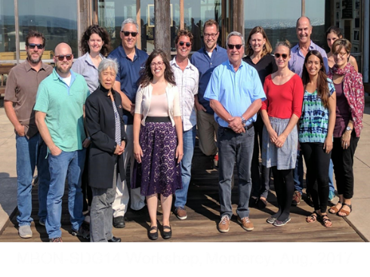
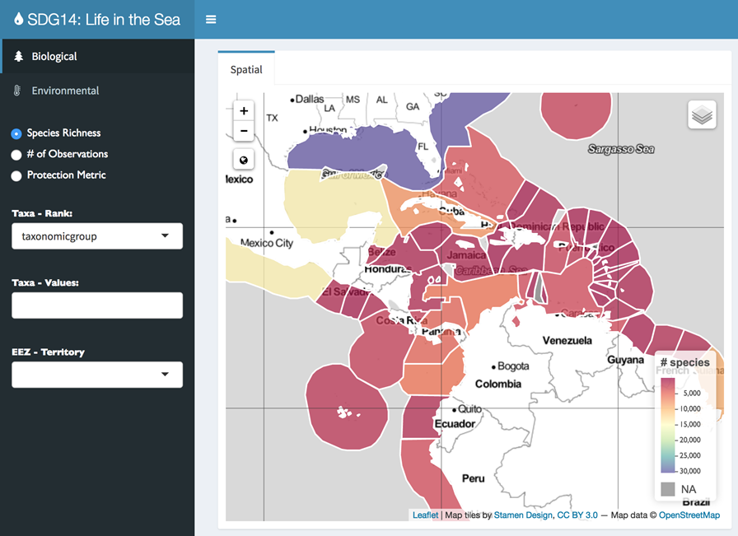
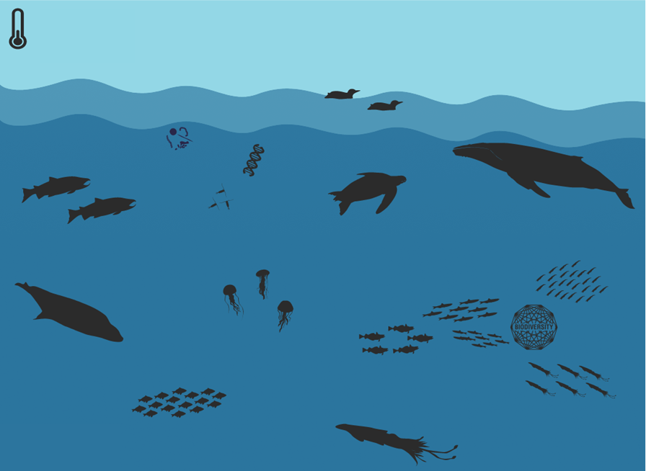
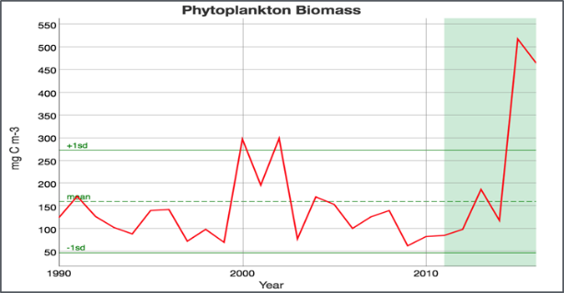







MBON Interactive Tools – “Data Storytelling”
Developed with users (State/Federal managers, ONMS)
Rolled out at 2017 GEO Plenary and Large Marine Ecosystem (LME 19) meetings
Requests from national governments, GEO themes, California Current IEA, others for demos and to adapt the tools for use
Explorer (Global)
Infographics (Local)
‹#›
Notes:
•MBON previewed two new data tools - "Explorer" and "Infographic" - at GEO Week 2017. NMFS S&T reps also presented the tools at the LME19 Large Marine Ecosystem annual meeting in Cape Town.
•These tools were developed with and for scientists and resource managers to support national reporting requirements, including for the UN "Life in the Sea" Sustainable Development Goal.
•The Explorer tool integrates environmental data, such as sea surface temperature (SST) and chlorophyll concentration, with biological data from OBIS.
•The Infographic tool, designed for managers, policymakers, educators, and the public, shows changes to key species, habitat conditions, and SST over time.
•The tools were created with open source software and follow standards defined by the Group on Earth Observations Biodiversity Observation Network.
•The demonstration tools are publically available at http://mbon.marine.usf.edu/
•A recording of the full 2 hour GEO Plenary side event is available on the MBON website and at https://youtu.be/71ENf0OHjfw

Slide 14
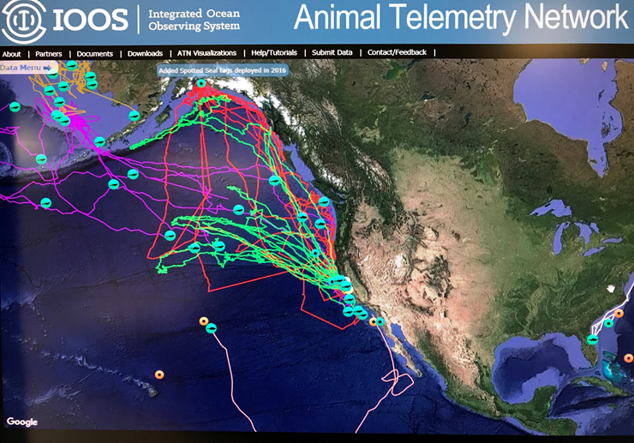
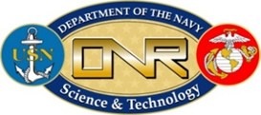
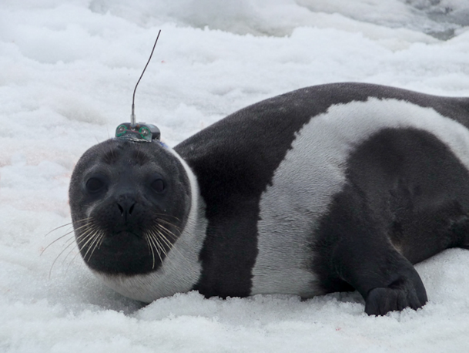


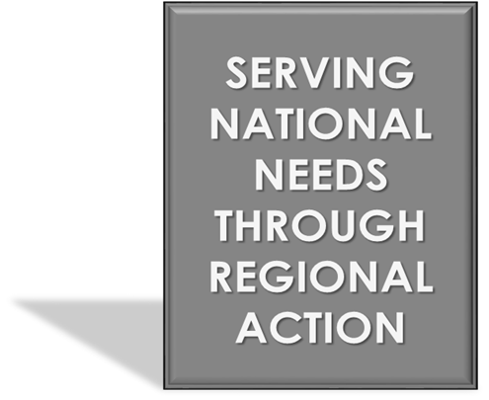
U.S. Animal Telemetry Network (ATN)
Photo Credit: Josh London
Vision: U.S. ATN is an observing system that can track aquatic animals and their habitats to provide data critical for the conservation and sustainable management of commercially harvested species, protected species, and other marine resources.
Implementation: Help to keep existing telemetry observing efforts going and add to them as needed and prioritized through regional Workshops and Steering Group guidance.
Data Assembly Center: Centralized community resource, receives satellite, acoustic and archival data from multiple sources, promote global data sharing and availability, permanent archiving at NCEI
Notes:
CY-2017 Highlights
Emphasis on forming alliances/collaborations, creating governance and implementing the ATN data management & delivery vision
Two meetings of the newly formed ATN Steering Group (SG): 9 federal agencies, 4 non-feds represented on the SG
Telemetry asset/effort inventory web-tool created
New Mid-Atlantic Telemetry Observation System (MATOS) web-based acoustic data aggregation tool developed by RPS/ASA is operational and will serve the ACT Region and more
Convened 3 Regional ATN Workshops with Stakeholders & Telemetry Practitioners: MARACOOS, SECOORA/CARICOOS and AOOS; 3 more coming in 2018
Many new live tracks displayed on the ATN website from BOEM/ONR PI’s: whales, sharks turtles…….
Successful ATN briefings to NMFS Science Board have led to an FY-18+ NMFS ATN funding agreement
Network Coordinator’s Annual Report submitted to BOEM
Science on a Sphere (SOS): ATN is working with the NOAA SOS Educational Outreach Coordinator to display marine animal telemetry tracks on the SOS
Monthly “From the ATN Wheelhouse” updates
Several candidate High-priority national ATN Program Assets and Infrastructure for Phase II procurement have been identified

Slide 15
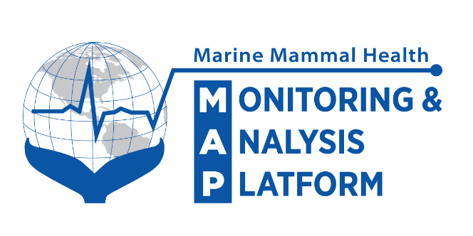
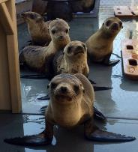

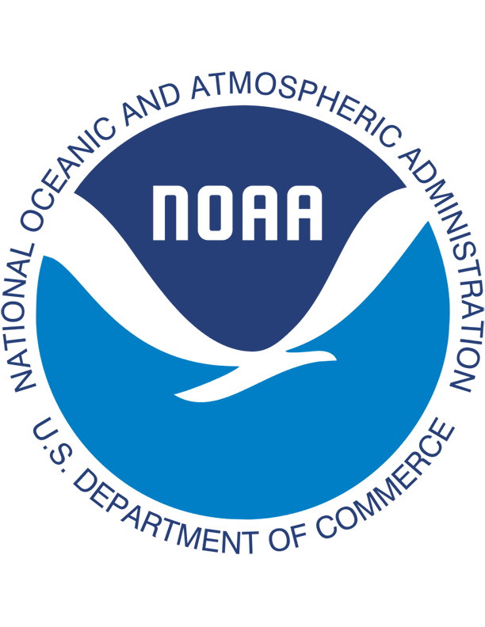
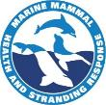

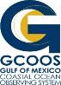





Marine Mammal Health Monitoring and Analysis Platform
Health MAP vision: For everyone to understand interactions between
marine mammal health, ocean health, & humans
2017 Activities and Accomplishments:
Further development of a prototype data platform in the Gulf of Mexico (Gulf MAP)
Gulf Environmental Benefit Fund through NFWF
Implementation of the standardized basic data fields
Completion of two build out projects
Developed a system design and architecture (GCOOS): Funded by the Marine Mammal Commission
Visualization & Data Exploration (Axiom Data Science): Developed the pilot project to visualize and allow interactions with data focused on GulfMAP but ultimately with national platform in mind. Funded by SeaWorld (via NFWF)
Updates: https://www.mmc.gov/priority-topics/marine-mammal-health-and-strandings/
Prototype Web Portal: http://axiomdatascience.com/maps/marine-mammal-health-map/#
Photo: Marine Mammal Care Center At Ft McArthur
Notes:
Need: near-real time access to centralized, standardized marine mammal health data.
Leaders: Marine Mammal Commission and the National Oceanic and Atmospheric Administration’s (NOAA’s) National Marine Fisheries Service (NMFS) Office of Protected Resources
Activity: Work with a growing number of partners to develop a nationally centralized, ultimately near-real-time, system for reporting data on marine mammal health called the Marine Mammal Health Monitoring and Analysis Platform (Health MAP).
IOOS: MMC came to us with a need for data management skills to help their long term vision for MMHMAP and we were able to pull in GCOOS and Axiom to help through funding from NMFS. We've helped them scope out a large system design and build a prototype portal in the Gulf of Mexico. We (I) participate in the MMHMAP exec team to ensure ongoing coordination but we (IOOS PO) are not spending our own $$ on this project. We're just maintaining a connection between regional dmac and MMC/NMFS

Slide 16
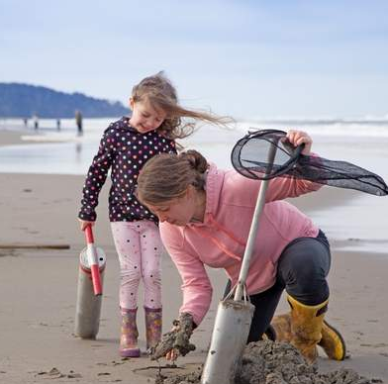
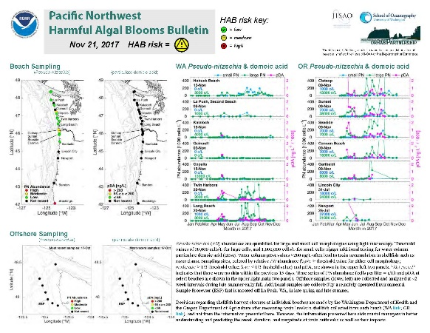
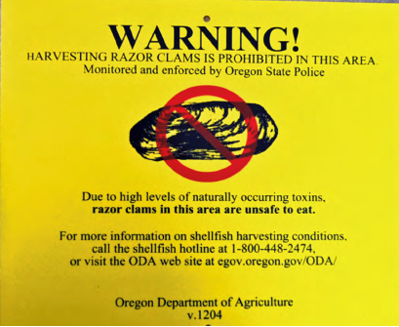






From samples to integrated products to digging for clams
Beach open or closed for clam harvesting
Pacific Northwest Harmful Algal Bloom Bulletin
Beach and at-sea sampling
Ocean circulation models
.
Notes:
•From samples to public impacts
Images from lower left to upper right
•HAB sampling includes ESP, collection of razor clams for toxin testing, ship-based sampling, beach plankton samples and modeling of currents and water properties based upon weather forecasts (WRF) and river and other inputs
•Middle image shows the Bulletin. A compendium of observed data – water and organism samples for toxic species and domoic acid, model data – LiveOcean for circulation and ocean properties, winds and weather forecasts – affect upwelling and transport of organisms, HF radar for surface currents – again for transport, longer term upwelling and El Nino indices and a textual interpretation and guidance for shellfish managers.
•Upper right shows digging for razor clams, or the sign posted when managers have had to close beaches for harvesting.
•
Pacific Northwest Harmful Algal Bloom Forecast Goes Operational
A bulletin to inform communities and combat the impacts of harmful algal blooms (HABs) in the Pacific Northwest went operational this year. Real-Time HABs, funded by the National Centers for Coastal Ocean Science and the National Marine Fisheries Service, integrates data from the U.S. Integrated Ocean Observing System (IOOS®) and is hosted by the Northwest Association of Networked Ocean Observing Systems (NANOOS, an IOOS regional association). The model- and observation-based HAB forecast is supported by data from IOOS, the University of Washington’s LiveOcean model, sampling by state and tribal groups, and other real-time observations. The bulletin also uses data from the Environmental Sample Processor (ESP), deployed near the Juan de Fuca eddy, a known HAB "hot spot." The ESP is an automated biosensor that collects and analyzes water samples every few days and transmits the data back to researchers. Developed by the Monterey Bay Aquarium Research Institute and supported by an IOOS Ocean Technology Transition Grant, the ESP is deployed in the Pacific Northwest and the Gulf of Maine to measure potentially harmful phytoplankton species and the toxins they produce.
•Additional note: CO-OPS also transitioned the Lake Erie HAB forecast to operations in 2017.

Slide 17
Building a “Community of Practice”
A sustained infrastructure for long-term biological observations requires community support to:
Integrate across disciplines - physical, chemical, biogeochemical, and biological obs;
Identify key indicators to guide observing strategies;
Contribute biological data to IOOS and OBIS;
Identify critical users and partnerships;
Stay connected with animal tracking and ‘omics efforts, including data management;
Build tools and skills - create a community around management of biological observing data.

Slide 18
An ongoing process...
US IOOS long-held interest in content and access standards for IOOS biological core variables to promote interoperability.
Decade+ partnership with OBIS-USA.
IOOS “Biological Data Projects” with Pacific Islands Fisheries Science Center and PacIOOS, SECOORA, GCOOS.
Early focus on enrollment process with OBIS-USA - heavy 1:1 training requirement.
Searching for ways to make DwC alignment more streamlined and efficient.
Regional and partner implementation.

Slide 19
Basic Principles and Assumptions
Data Sharing is desired and assumed
Desired by everyone to increase the impact of the observations (Measure once, use many times)
Interact through APIs
No back doors!
Forcing this principle into your system of systems design will build a stronger distributed infrastructure than ad hoc, point to point solutions for exchanging info
There is no single format that will satisfy everyone
Find cheap and stable ways to provide options
There are customers for your data that you have not yet met
Include ways to collect feedback from them
Be a good WWW citizen
Engage and listen to social scientists and non-oceanographers when designing
Notes:
Data should be standards-based for wider accessibility
The partnership with OBIS and alignment to the DwC standard is critical for biological observations and data
Consistent focus on promoting common access standards (e.g. the NOAA Environmental Research Division’s Data Access Program (ERDDAP)Interacting through APIs such as ERDDAP supports a distributed infrastructure.
You can always build a website on top of an ERDDAP server

Slide 20
Workshop Overview
Scope
IOOS and OBIS standards and tools for biological data
Web services for data access
Darwin Core, WoRMS (taxonomy) and metadata standards
Hands-on data exercises
Outcomes
Expand the IOOS and OBIS network of collaborators
Increase awareness of standards and best practices for marine biological data to improve data quality
Increase amount of marine biological data published through IOOS and OBIS
Increase availability of marine biological data for science, species conservation and ecosystem-based management

Slide 21
Workshop Objectives
On the road to a Community of Practice:
Understand the Global Context of our efforts: OBIS, GOOS, & Essential Ocean Variables
Review applications of biological data
Learn about OBIS Data, Darwin Core, Taxonomic and Metadata Standards
Start Aligning your data to Darwin Core!
Learn about ERDDAP’s capabilities
Discover tools for Data Access, Visualization, and Publication
Notes:
Understand the Global Context of our efforts: OBIS, GOOS, & Essential Ocean Variables
-Ward, Abby
Review applications of biological data -Axiom, Ben, Maria
Learn about OBIS Data, Darwin Core, Taxonomic and Metadata Standards -Ward , Abby, Samuel
Start Aligning your data to Darwin Core!
-Abby and Samuel
Learn about ERDDAP’s capabilities Kevin O’Brien
Discover tools for Data Access, Visualization, and Publication
-Axiom staff, Abby, Samuel, Filipe

Slide 22
Notional IOOS Biological Data Flow
Biological Data
Legend
Data
Decision
Yes
Does data have Scientific Name, Lat/Lon, and Date?
Align to DwC
Server
Process
DwC
Biological Data
No
Portal
OBIS-USA
harvest temporary
ERDDAP
Server
Seascapes
Data
SDG-14 MBON Explorer
Axiom harvest
IPT
(OBIS-USA)
iOBIS harvest
Axiom
harvest
MBON Portal
Explorer linked
from Portal
iOBIS

Slide 23
Workshop Agenda: Thursday
9:30 - 10:00 The Global Context: OBIS, GOOS, & Essential Ocean Variables
(Ward Appeltans)
10:00 - 10:15 Break
10:15 - 11:30 Applications of Biological Data
(Luc Mehl, Ben Best, Maria Kavanaugh)
11:30 - 12:00 Discussion with the RA Directors
12:00 - 1:00 Lunch (Catered)
1:00 - 1:45 OBIS Data, Taxonomic and Metadata Standards
(Ward Appeltans)
1:45 - 2:00 Break 2:00 - 2:45 Darwin Core (DwC) - More than Occurrence and Abundance
(Abby Benson)
2:45 - 3:15 DwC Alignment data demonstration
(Marion Stoessel & Lynn DeWitt)
3:15 - 5:00 Hands on work: Align your dataset to DwC

Slide 24
Workshop Agenda: Friday
8:30 - 9:00 Configuring Biological Data for ERDDAP
(Kevin O’Brien)
9:00 - 10:30 Hands on work
10:30 - 10:45 Break 10:45 - 11:30 Data Wrangling
(Samuel Bosch, Ben Best, Filipe Fernandes)
11:30 - 12:00 More Hands on work
12:00 - 1:00 Lunch (Catered)
1:00 - 3:00 Data Access, Visualization, and Publication
1:00 - 2:00 MBON Portal Demonstration
(Axiom - Luc Mehl & Stacey Buckelew)
2:00 - 3:00 OBIS Portal User Interface Demonstration
(Abby Benson & Samuel Bosch)
3:00 - 3:15 Break
3:15 - 4:30 Hands-On and Wrap-Up

